Slide 1
Honey Find Savings (Sephora) Analysis
How can we improve product performance and monetization in 2020?

Slide 2
Assumptions
Missing values for Commission indicate that Honey received $0 commission for that transaction:
In other words, missing commission does not imply missing data from Sephora. 13,699 out of 27,714 records have missing commission values. Having almost half of a dataset with a missing value is unlikely, but not impossible, and so I conclude these are $0 commission transactions.
The Date variable does not correspond to a User Transaction date, and instead likely maps to a Data Collection or Ingestion date, judging by the lack of spread in the distribution below.

Slide 3
Product Optimization – Code Run Duration
At the device level, we see that Chrome performs really well (average code run duration of ~15 seconds) and is the source of most of our transactions. However, the code run duration for other browsers is significantly higher and could be scoped for optimization.
Similarly, among the most commonly applied codes, we see that TWENTYOFF and 2018HOORAY have almost double the average run duration as the others.
Recommendation: The code selection algorithm can keep a running track of its frequent recommendations to suggest them first and cut down code run duration in future iterations.

Slide 4
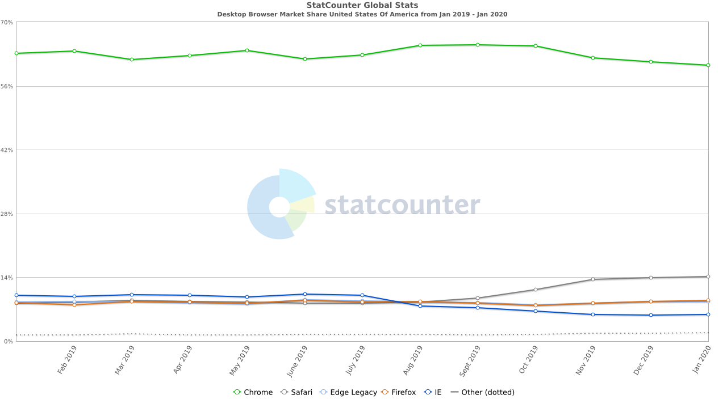
Product Opportunity – Safari Extension
In January 2020, Chrome had 61% of the Desktop Browser market in the US, while Safari had 14%.¹
Recommendation: Launching the Honey extension for Safari (or, at least enabling it with Sephora) could yield (14%/61%) * 16,298 Chrome Transactions = 3,750 Safari transactions with Sephora over the next few months, assuming we penetrate a similar proportion of the Safari market as we have for Chrome.
¹“Desktop Browser Market Share in United States Of America - January 2020.” StatCounter, https://gs.statcounter.com/browser-market-share/desktop/united-states-of-america.

Slide 5
Commission is the Mission
13,882 out of 27,714 Sephora transactions have $0 or missing commission, representing about 50% of all transactions from September – December 2018.
Pivoting from Product recommendations to Monetization strategies, we will explore how to improve this “no commission rate” by looking at Final Cart Prices.

Slide 6
“No Commission Rates” – Transactions with High Cart Final Price
We can clearly see that we derive most of our commission through small carts which account for a large number of our transactions. However, observe the spike in total revenue earned for transactions with CFP > $1000, due to the high value of these carts.
Notice also that the “no commission rate”, i.e., percentage of transactions with $0 commission, creeps higher with larger carts, and is highest for transactions with CFP > $1000. A high CFP implies a combination of high value and a large number of items in the final cart.
Hypothesis 1: Certain items currently exclude the whole cart from earning a commission. Hence, carts with more items are more likely to lose out on commission. However, these high value transactions would net us the most commission if awarded.
Hypothesis 2: Users take longer to finalize high value carts. This lag time could cause errors in tracking and attribution to Honey, causing us to lose out on commissions despite the user still using a Honey code to finish the transaction.
Recommendation: Investigate which items cause no commission to be awarded and why; re-negotiate the terms of our contract with Sephora to still award a commission even if an ineligible item is part of a transaction. Investigate attribution when a user takes a long time to finish a transaction (say, weeks or months).

Slide 7
Conclusion
The Find Savings product does well with small carts and on Chrome.
There is opportunity to improve the code run duration on alternate browsers and for frequently used codes.
A reduced code run duration would also benefit a potential future release on Safari.
50% of Sephora transactions had no commission, many of these being higher value carts. This implies certain items cause the entire cart to become ineligible for commission, and/or errors in tracking and attribution to Honey. Investigating ineligible items and Sephora’s attribution model to solve the root cause of this issue could yield huge boosts to overall commissions.

Slide 8
Future Improvements
Including an “Invite Friends” option to the extension, with a reward coupon as incentive, to introduce a viral factor to the Honey product
Increase the number of transactions on Edge, Firefox and eventually Safari by advertising the Honey extension installing natively on those browsers – since current marketing is targeted towards Chrome users
Is code run duration proportional to how many possible codes could have been applied?
Does the algorithm always correctly identify the "best code"? A list of all codes considered for a transaction could be used to monitor the efficiency of the algorithm.
When is commission not paid out? I would be curious to see data containing the number of items in a cart to verify my first hypothesis. I would also like to see cart start and cart finish date to verify my second hypothesis.
It would be nice to have Transaction Date and not Ingestion Date – as of now, it is difficult to ascertain any seasonality or temporal trends in the data.
Transaction data from other partners could prove invaluable – there were only a handful of repeat users in this dataset. With more partner data, Honey’s “power users” could be identified and could inform activation, engagement and retention metrics for the product.

